Slide 1

KKR & KSR INSTITUTE OF TECHNOLOGY AND SCIENCES
DEPARTMENT OF ARTIFICIAL INTELLIGENCE
GLAUCOMA STAGES DETECTION USING FUNDUS IMAGES THROUGH DEEP LEARNING
Batch no :7
---------------------------------------------
CHENNAM. HEMA SIRISHA - 20JR1A4302
LAVU .SUMA SRI – 20JR1A4317
THOKALA .MINI ROSE – 20JR1A4328
UNDER THE GUIDANCE OF
K. RADHIKA.Asst Professor

Slide 2
ABSTRACT
A chronic eye condition called glaucoma has a deleterious effect on the optical nerve, which links the brain and eye to transmit visual information.
Early detection is essential for stopping the condition's progression.
Glaucoma is one of the most prevalent eye conditions, and it's important to catch it early because it can cause blindness and neurological issues.
In this study, a Deep Learning system is proposed for the early detection of glaucoma.

Slide 3
The eye image undergoes pre-processing to eliminate any noise and prepare them for further analysis.
The system utilizes enlarged images of the eyes as input data for the deep learning method.
The suggested system classifies new eye images as No_glaucoma ,Glaucoma_early, Glaucoma_moderate, and Glaucoma_advanced
And also provides respective preventive measures based on the features it learned during training.

Slide 4
INTRODUCTION
Glaucoma is a leading cause of blindness globally, characterized by long-term neurodegeneration in the eyes.
The World Health Organization estimates around 65 million people worldwide are affected by glaucoma.
Glaucoma often exhibits no symptoms until significant vision loss occurs, emphasizing the importance of early detection and treatment.
Loss of optic nerve fibers, a primary symptom, can occur without noticeable warning signs.
Increased intracranial pressure or decreased blood flow to the optic nerve contributes to vision loss in glaucoma.
Optic nerve transmits visual data from the brain to the eye, crucial for sight.

Slide 5
Pathologically high intraocular pressure, sometimes reaching 60-70 mmHg, is indicative of glaucoma.
Even prolonged pressure levels below 25-30 mmHg can lead to visual impairment.
Glaucoma-related high intraocular pressure results from compromised fluid drainage in the eye.
Fluid equilibrium within the eye is disrupted in glaucoma, leading to increased pressure.
Fundus photography, capturing the eye's background using a fundus camera, is a common diagnostic method in ophthalmology.
Analyzing fundus images for glaucoma diagnosis is time-consuming and may lack accuracy, necessitating supervised learning methods for classification.

Slide 6
LITERATURE REVIEW
S.No | Title | Authors | Journal Name | Year | Core Concept
1 | Glaucoma detection based on deep convolutional neural network | Chen | IEEE | 2015 | A system was developed to detect Glaucoma. They applied a six-layer CNN architecture.
2 | Automated glaucoma diagnosis using deep learning approach | Baida AI Bander | IEEE | 2017 | Developed a model which uses a pre-trained AlexNet model which consists of 23 layers and SVM Classifier
3 | Deep CNN-based patch classification for retinal nerve fiber layer defect detection in early glaucoma. | Rashmi Panda | NLM | 2018 | Introduced method that performs detection in fundus images using patch characteristics driven RNN
4 | Deep Learning-Based Glaucoma Screening Using Regional RNFL Thickness in Fundus Photography | Ahn | NLM | 2022 | Suggested an approach utilizing CNN with 3 convolutional layers and maxpooling applied at each layer followed by 2 fully connected layers.

Slide 7
EXISTING SYSTEM
Glaucoma can be identified by the method using fundus images.
Convolutional neural networks are used in the suggested novel system.
The original images are collected from a dataset or source and subjected to data augmentation.
Pre-processing is performed to addressing issue of blurry or unclear images, which includes color space conversion, image reconstruction, and image enhancement.

Slide 8
These steps utilize grayscale tones, where white represents the highest intensity and black is the lowest.
Rotation, zoom in, and zoom-out techniques are used to create new data with different exposures.
This is crucial for achieving a balance between the two classes of glaucoma.

Slide 9
PROBLEMS OF EXISTING SYSTEM
1.Inadequate Image Pre-processing Techniques:
There's a shortage of effective techniques to address different image distortions, risking errors in classification.
Also, the diversity in fundus image qualities isn't fully acknowledged, impacting the efficiency of subsequent processing stages.
2. Limited Feature Extraction Capabilities:
The current methods fall short in recognizing key features from fundus images, risking missed diagnostic cues.
Advanced algorithms are needed to capture subtle signs of glaucoma accurately, enhancing diagnostic precision.

Slide 10
3. Challenges in Classification:
Difficulty in achieving precise classification due to the complexity of glaucoma diagnosis and the subtle variations in fundus image characteristics.
Potential bias or imbalance in the dataset used for training, leading to skewed classification results and reduced generalizability of the model.
4. Suboptimal System Architecture:
Insufficient optimization or refinement of the CNN architecture, potentially limiting its capacity to effectively process fundus images and discern relevant features.
Lack of adaptation to emerging advancements in deep learning architectures and techniques, hindering the system's potential for improved performance and accuracy.

Slide 11
PROPOSED SYSTEM
The proposed system aims to detect stages of glaucoma and gives the preventive measures to their respective stages using fundus images sourced from Roboflow.
Leveraging deep learning models such as MobileNet and InceptionV3, the system seeks to achieve high accuracy in glaucoma stage classification.
The system's architecture encompasses data preprocessing, model training, evaluation, and deployment, ensuring a comprehensive approach to glaucoma detection.

Slide 12
IMPLEMENTATION
1. Dataset Preparation: Organize images into training, validation, and testing directories with proper labeling.
2. Data Augmentation: Apply techniques like rotation, shifting, and flipping using `ImageDataGenerator` to augment training data.
3. Model Selection: Choose MobileNetV2 as the base model for its efficiency and effectiveness in image classification tasks.
4. Model Building: Load MobileNetV2 without top layers and add custom layers like GlobalAveragePooling2D, Dropout, and Dense for classification.
5. Model Compilation: Compile the model with Adam optimizer, reduced learning rate, categorical cross-entropy loss, and accuracy metric.

Slide 13
6. Callbacks: Implement ReduceLROnPlateau, ModelCheckpoint, and EarlyStopping callbacks to optimize training.
7. Model Training: Train the model for 20 epochs on the augmented training dataset, validating on the validation set.
8. Model Evaluation: Assess the trained model's performance on the test dataset to measure accuracy and generalization.
9. Model Saving: Save the trained model as 'glaucoma_model.keras' for future use or deployment.
10. Deployment: Deploy the saved model in a Streamlit web application for real-time glaucoma prediction from uploaded eye images.

Slide 14
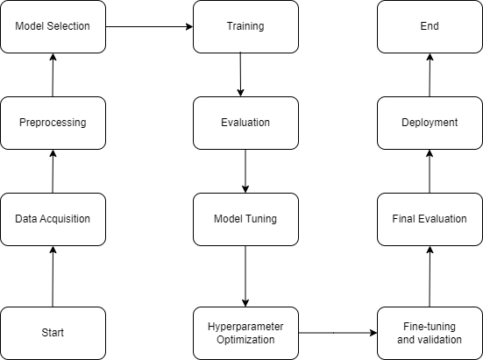
IMPLEMENTATION DESIGN

Slide 15
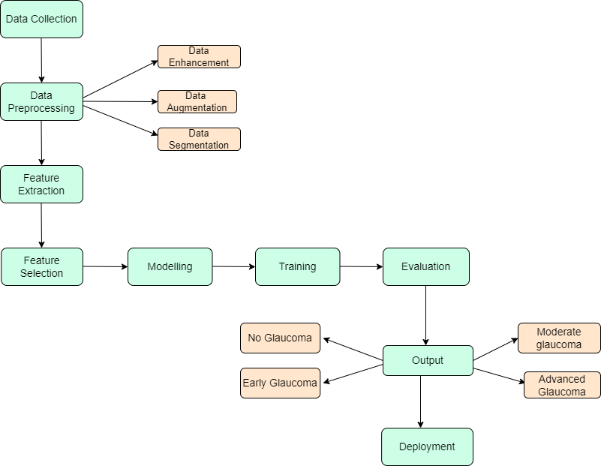
ARCHITECTURE

Slide 16
MODULES
MobileNetV2 is a convolutional neural network (CNN) architecture utilized for glaucoma stage detection using fundus images.
The process typically involves:
1. Data Collection: Assemble a comprehensive dataset of fundus images depicting various stages of glaucoma.
2. Data Preprocessing: Prepare the images for training, which may entail resizing, normalization, and data augmentation to enhance the diversity of the training set.
3. Model Training: Train the MobileNetV2 model on the annotated fundus image dataset. Techniques like transfer learning can be applied to leverage pre-trained weights, speeding up convergence and improving performance.

Slide 17
4. Model Evaluation: Evaluate the trained MobileNetV2 model on a separate test dataset to gauge its accuracy, precision, recall, and other relevant metrics, ensuring its effectiveness in glaucoma stage detection.
5. Deployment: Incorporate the trained MobileNetV2 model into a system or application for automated glaucoma stage detection, providing a valuable tool for early diagnosis and treatment.

Slide 18
TECHNOLOGIES USED
1.Deep Learning: Deep learning techniques are employed for training the glaucoma detection models. These techniques involve neural networks with multiple layers that can automatically learn hierarchical representations of fundus images to identify glaucoma stages.
2. Roboflow: Roboflow is employed for managing and preprocessing the fundus image dataset used for training the glaucoma detection models. It offers tools for annotating, augmenting, and organizing image data, streamlining the data preparation process.
3.TensorFlow: TensorFlow serves as the primary deep learning framework for

Slide 19
implementing and training the glaucoma detection models. It provides a comprehensive set of tools and APIs for building and optimizing deep neural networks.
4. Keras: Keras, as a high-level neural networks API, is likely utilized in conjunction with TensorFlow for rapid prototyping and experimentation with different model architectures. Keras simplifies the process of designing, training, and evaluating deep learning models.
5. Streamlit: Streamlit is utilized to create a user-friendly web application for interacting with the trained glaucoma detection models. It enables healthcare professionals to upload fundus images and receive predictions regarding the stages of glaucoma in real time.

Slide 20
SOFTWARE REQUIREMENTS
1. Python: The code is written in Python, so Python interpreter is required.
2. Tensor Flow: Tensor Flow library is used for building, training, and deploying deep learning models.
3. NumPy: NumPy is used for numerical computations and array manipulations.
4. PIL: PIL (Python Imaging Library) is used for image processing tasks, such as loading and resizing images.
5. Streamlit: Streamlit library is used for building interactive web applications for machine learning projects.
6. Any Web Browser: The Streamlit web application can be accessed through any web browser for uploading images and viewing predictions.
7. Jupyter Notebook: Jupyter Notebook have been used for development and testing purposes.

Slide 21
TEST CASE REPORTS
S.NO | Test Scenario | Expected Result | Actual Result | Status
1. | Image Upload | Selected image should be displayed on the screen. | Successfully displayed the selected image on screen. | Pass
2. | Prediction | Model should predict the Glaucoma stage. | Predicted the particular Glaucoma stage. | Pass
3. | Normal eye image. | Model should detects the NoGlaucoma . | Detected absence of Glaucoma. | Pass
4. | Severely Advanced Glaucoma | Model should detects the NoGlaucoma . | Detected Severe advanced glaucoma | Pass
5. | Preventive Measures Display. | Preventive measure should be displayed for Detected Glaucoma stage. | Successfully displayed the preventive measure for detected stage | Pass

Slide 22
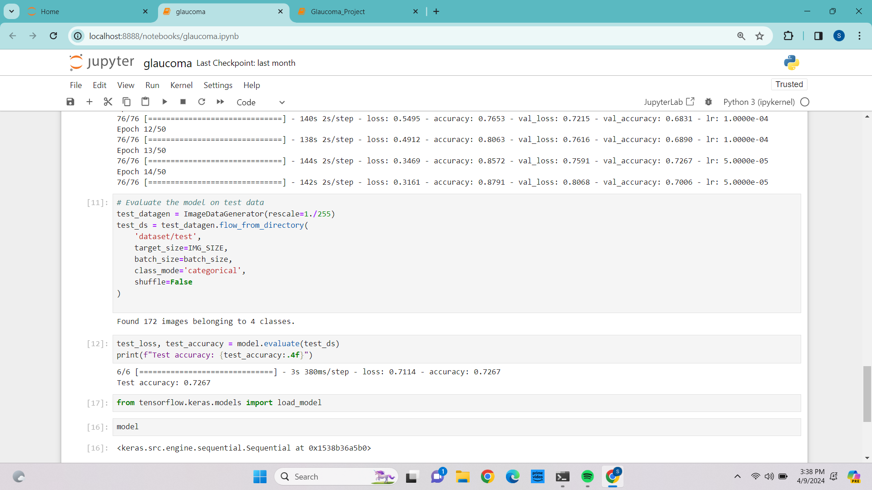
TEST ACCURACY

Slide 23
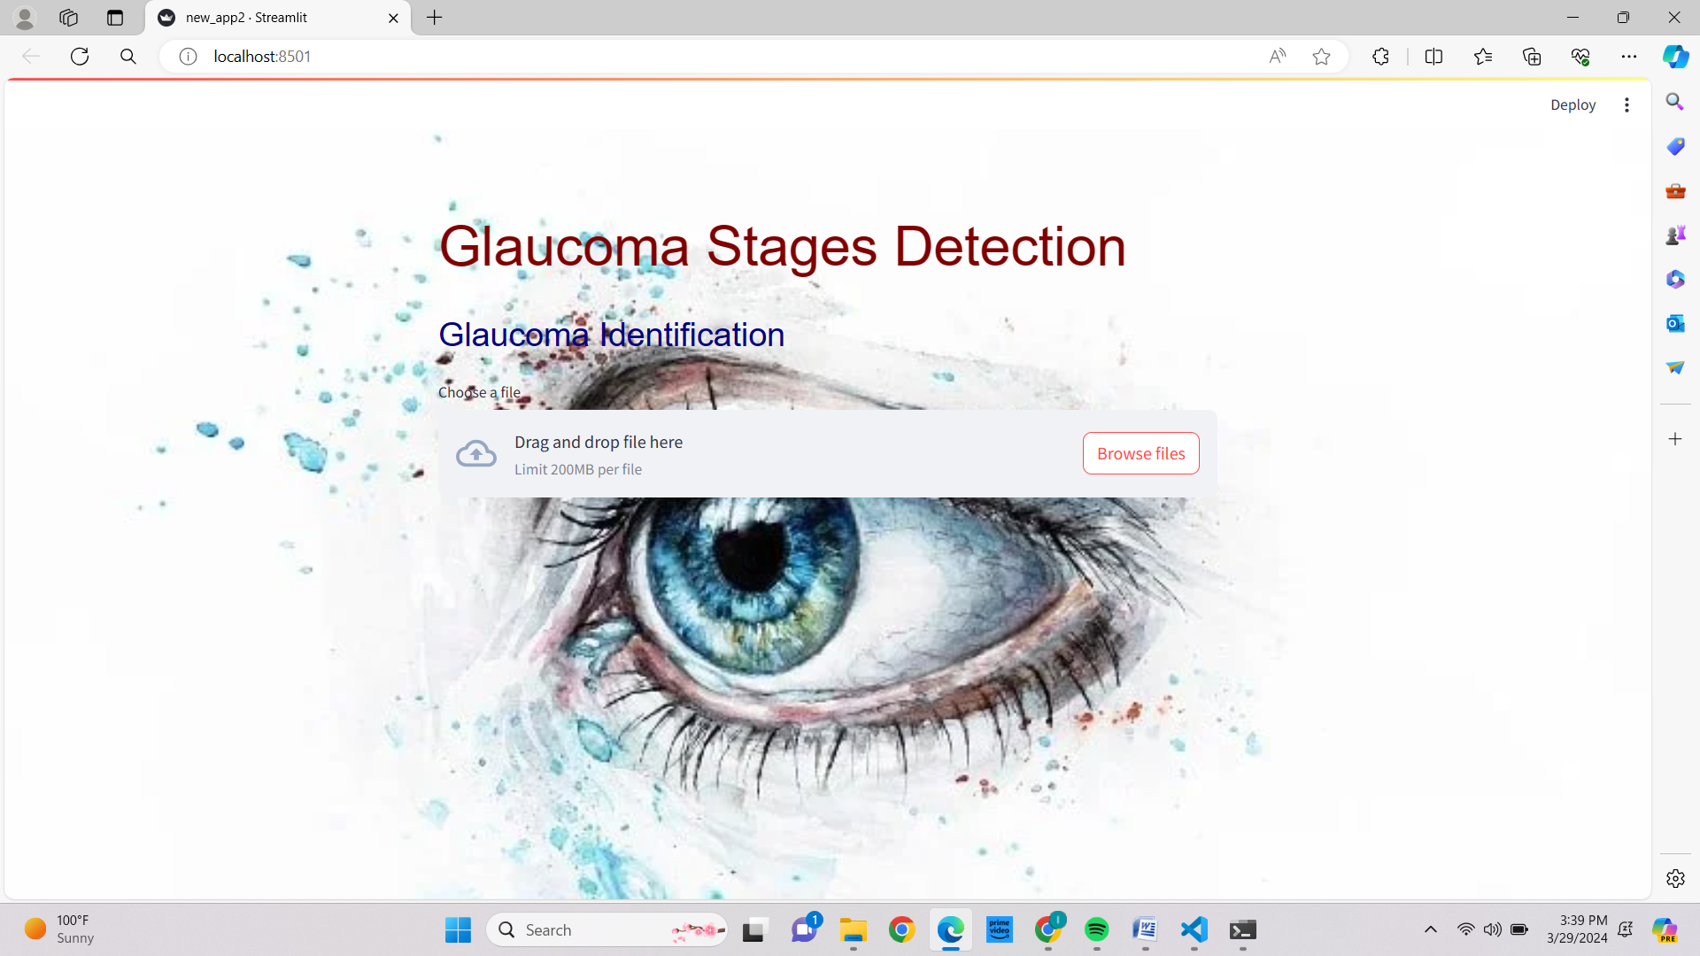
OUTPUT
O

Slide 24
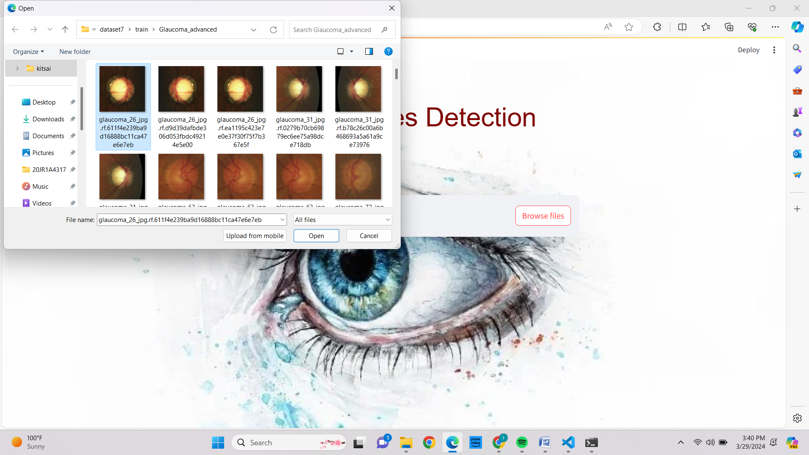

Slide 25
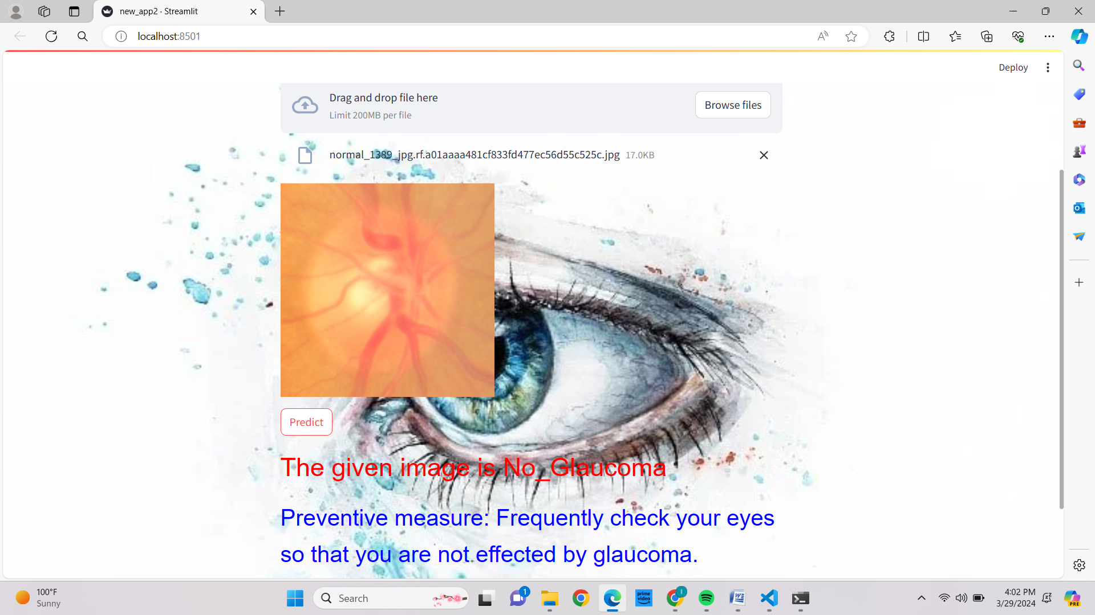
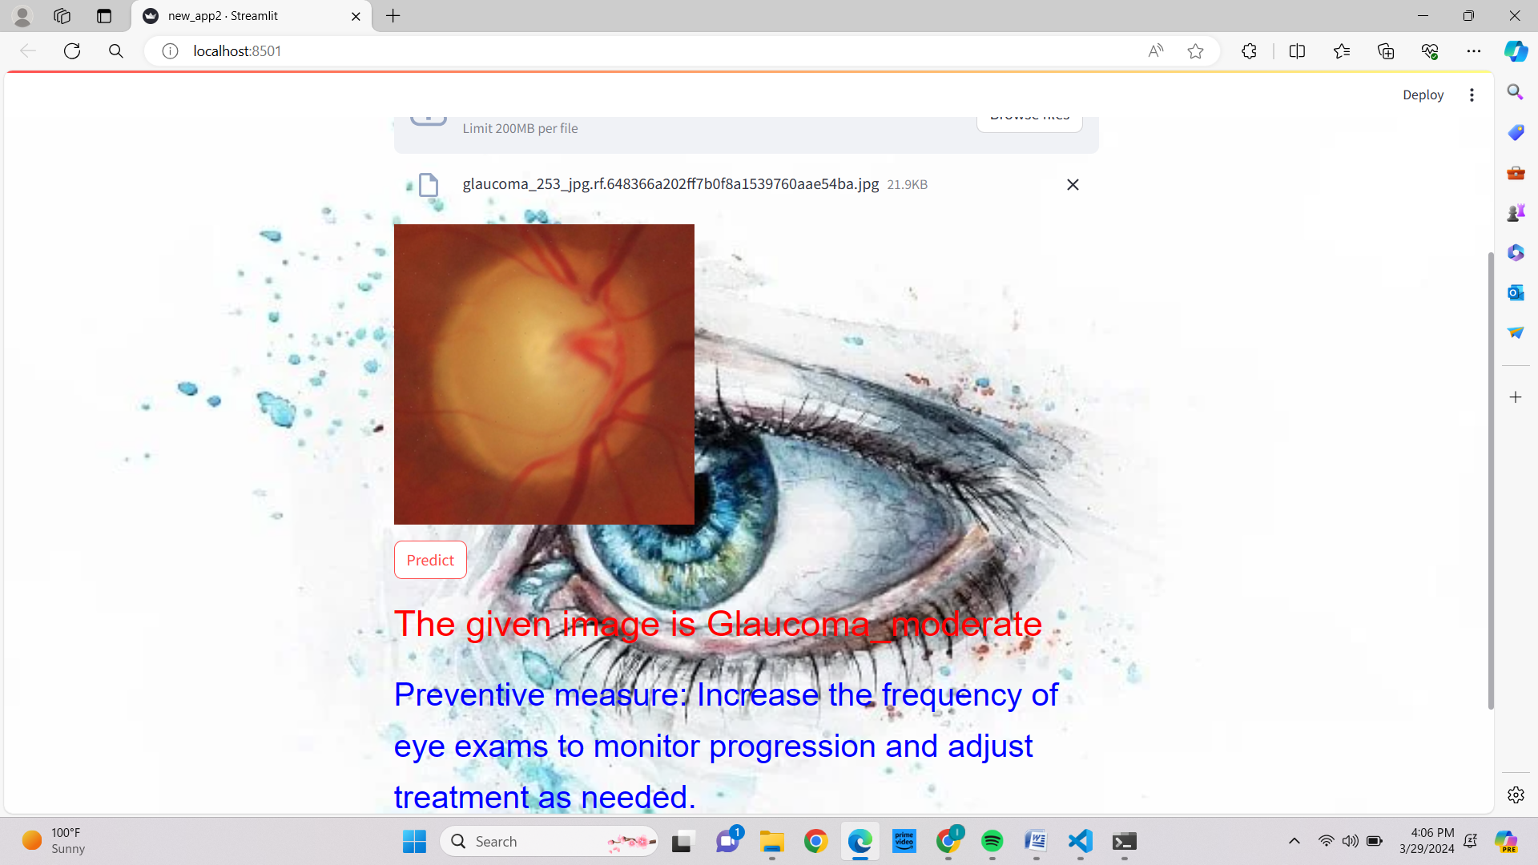

Slide 26
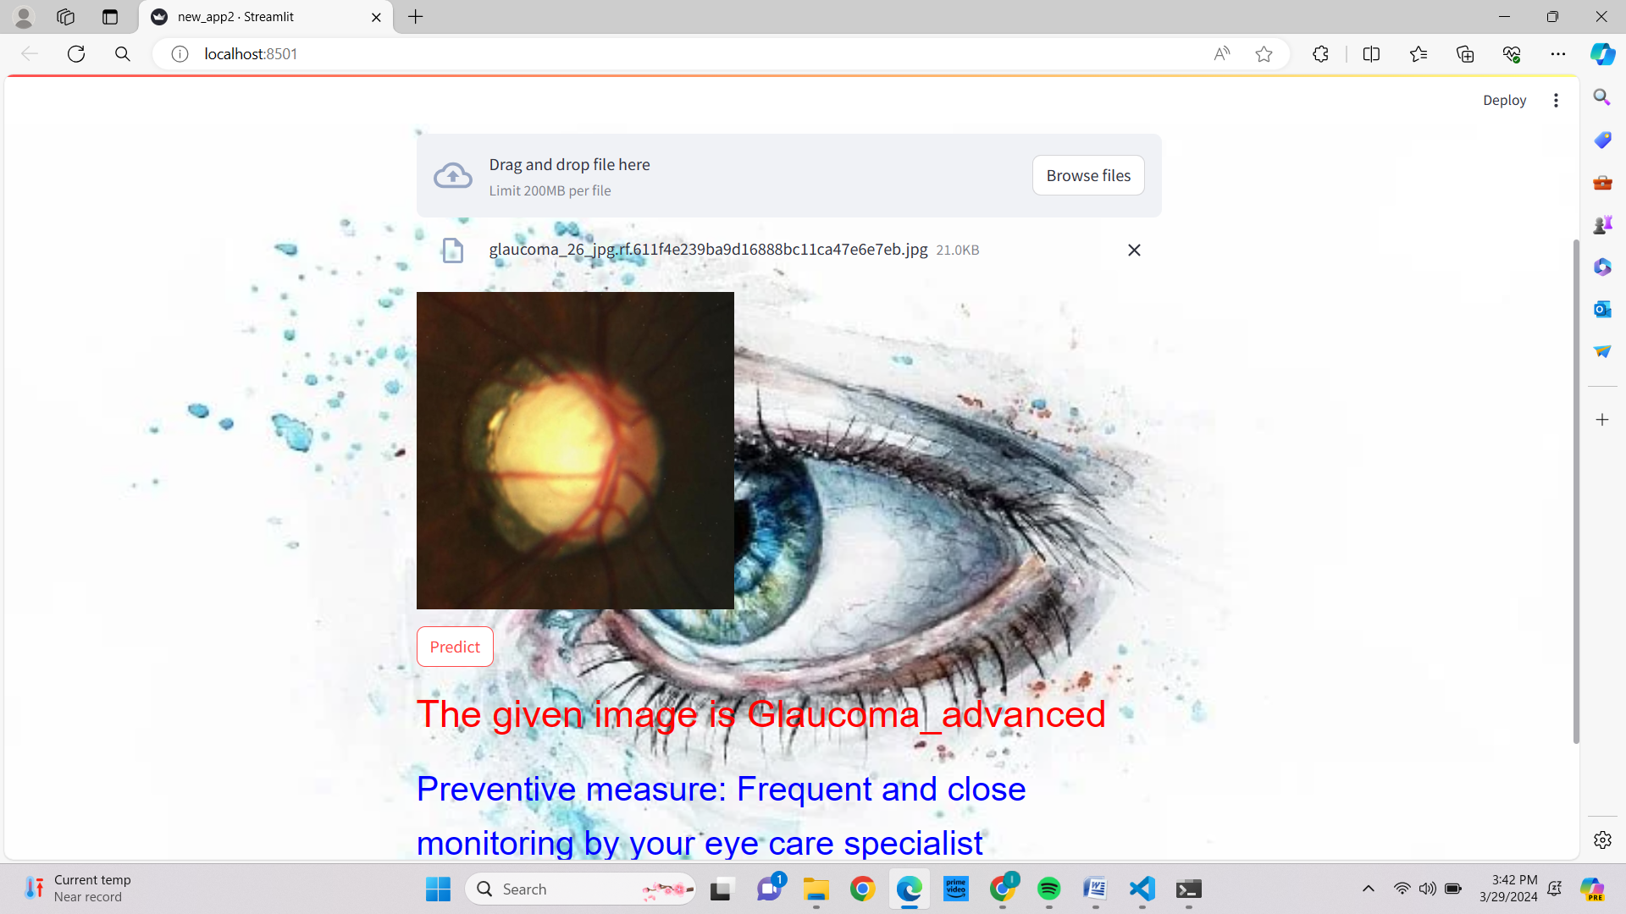
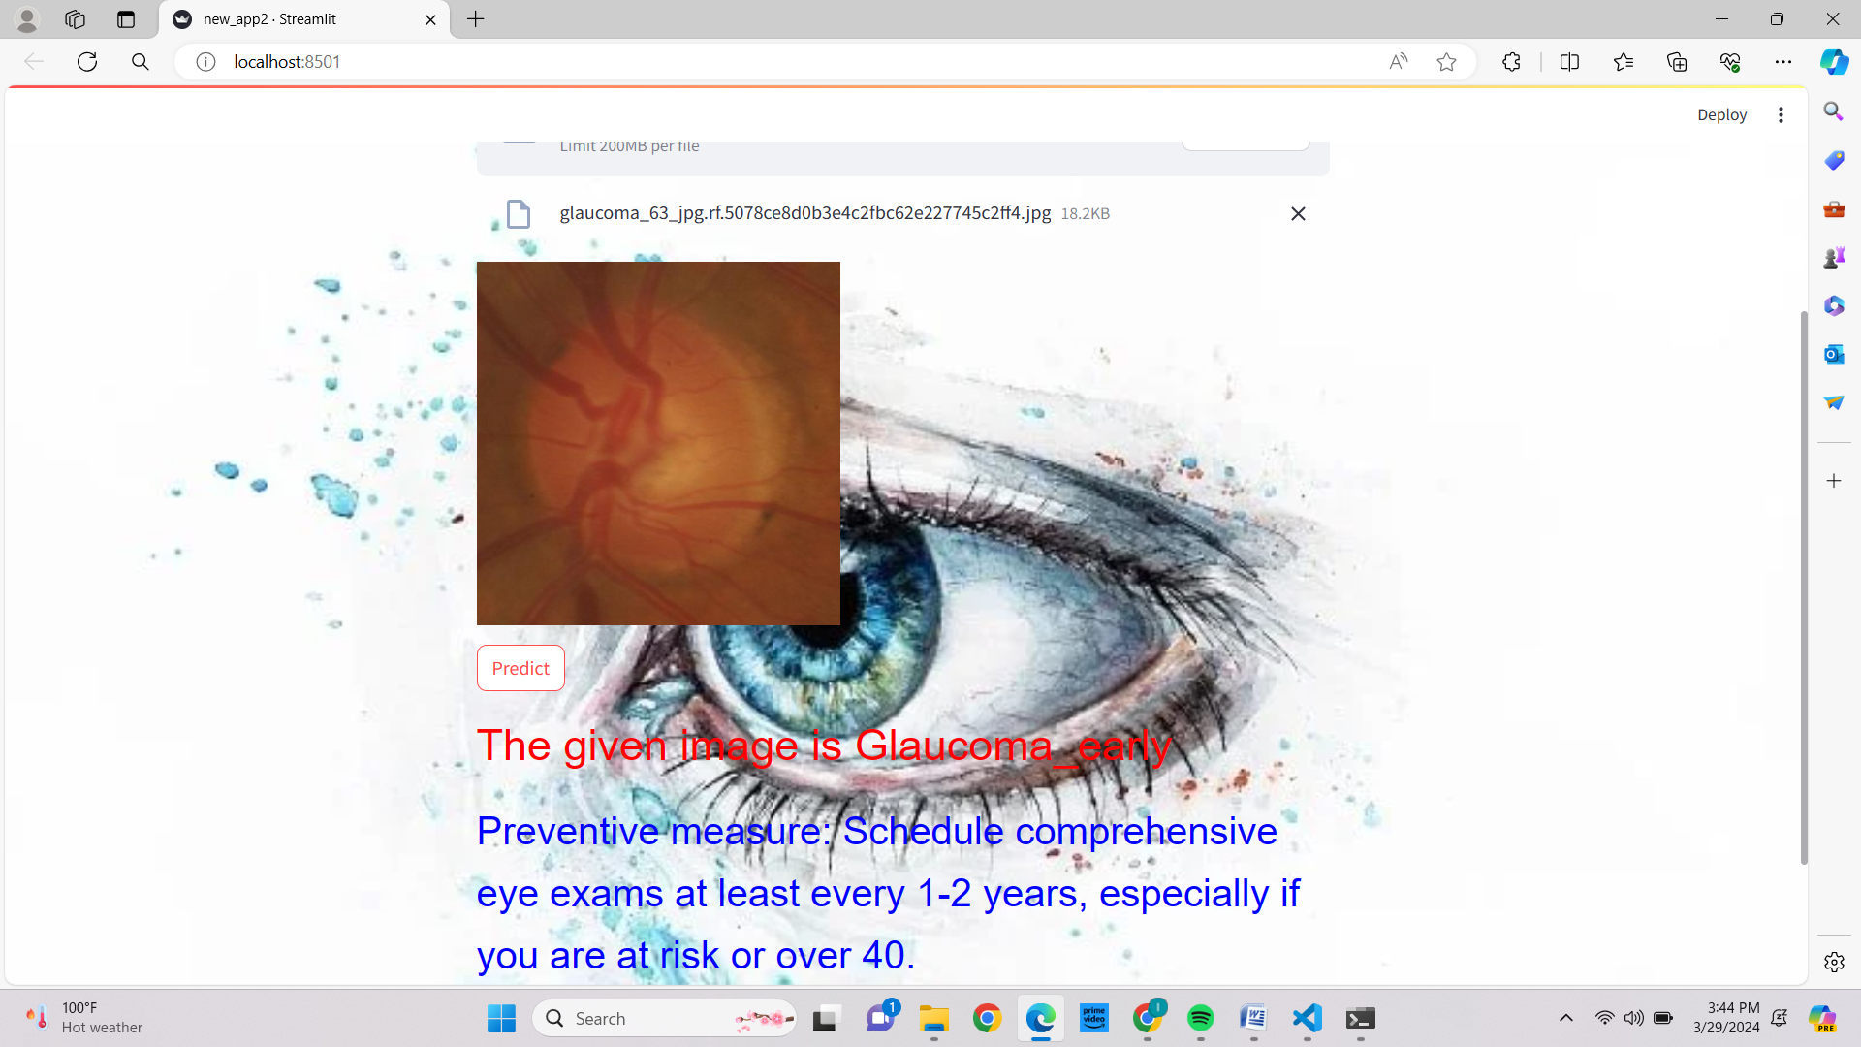

Slide 27
CONCLUSION
Our project addresses early detection and management of glaucoma using advanced technology. Leveraging Roboflow and MobileVNet, we created an accurate solution for glaucoma diagnosis. Streamlit facilitated user-friendly frontend development, allowing easy image upload, prompt assessments, and access to preventive measures. We prioritize privacy and compliance, ensuring trust and transparency in model predictions. By democratizing glaucoma assessment, we bridge the gap between technology and healthcare. Our project opens avenues for further research in computer-aided diagnosis and telemedicine, including expanding to cover other eye diseases and refining detection algorithms

Slide 28
FUTURE ENHANCEMENTS
Transfer Learning Extension: Extend transfer learning by fine-tuning the model on a larger and more diverse dataset specific to eye conditions, enhancing its ability to generalize to a wider range of cases.
Advanced Data Augmentation: Implement advanced augmentation techniques like generative adversarial networks (GANs) or style transfer to synthesize diverse and realistic eye images, enriching the training data and improving model robustness.
Interactive Visualization Tools: Develop interactive visualization tools that allow medical professionals to explore model predictions, understand decision rationale, and provide feedback, fostering collaboration and improving trust in the model's outputs.
Continuous Model Monitoring: Establish a system for continuous monitoring of the deployed model's performance and generalization across different populations or demographics, facilitating timely updates and ensuring sustained effectiveness.

Slide 29
Thank you !

